Slide 1
Introduction to Catalysis
William F. Schneider

Slide 2
What is a “Catalyst”
A catalyst (Greek: καταλύτης, catalytēs) is a substance that accelerates the rate of a chemical reaction without itself being transformed or consumed by the reaction. (Wikipedia)
k(T) = k₀e^{-Ea/RT}
E_{a}′ < E_{a}
k₀′ > k₀
k′ > k
ΔG = ΔG
uncatalyzed
catalyzed
E_{a}
E_{a}′
A + B
A + B +
catalyst
ΔG
ΔG
C
C + catalyst

Slide 3
Catalysts Open Up New Reaction Pathways
‡
H
O
H₂C
C
O
OH
CH₃
C
C
CH₃
CH₃
‡
CH₂
CH₃
propanone
propenol
propenol
propanone

Slide 4
Catalysts Open Up New Reaction Pathways
O⁻
C
+ H₂O
CH₂
CH₃
OH⁻
−OH⁻
Base catalyzed
O
OH
rate = k[OH⁻][acetone]
C
C
‡
‡
CH₃
CH₃
CH₂
CH₃
propenol
propanone
intermediate

Slide 5
Catalysts Open Up New Reaction Pathways
‡
‡
propenol
different
intermediate
propanone
O
OH
rate = k[H₃O⁺][acetone]
C
C
Acid catalyzed
CH₃
CH₃
CH₂
CH₃
OH
C
H₃O⁺
+
−H₃O⁺
CH₃
CH₃
+ H₂O

Slide 6
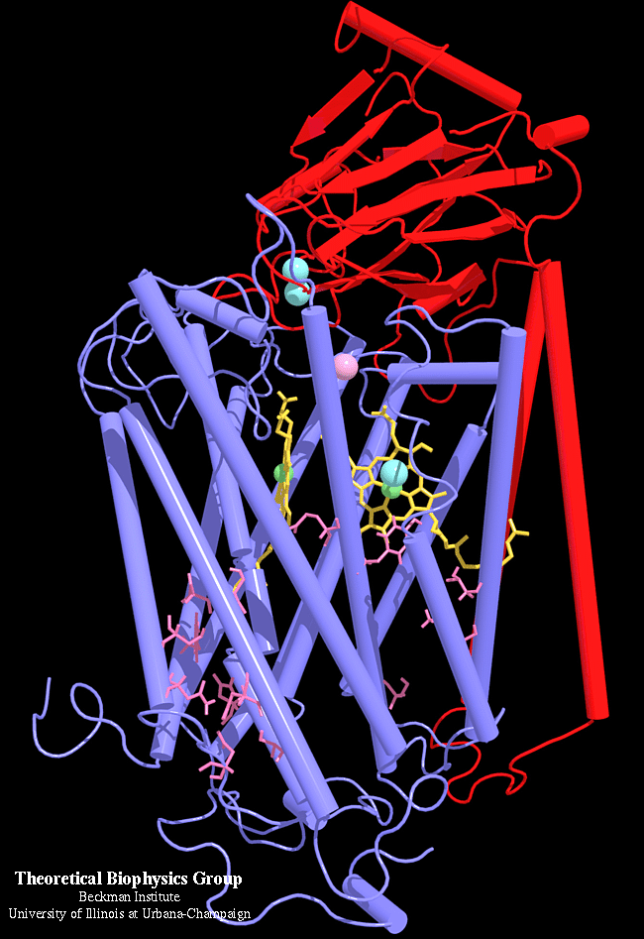
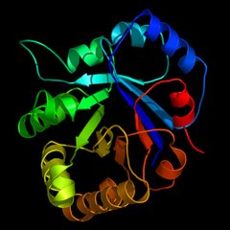
Types of Catalysts - Enzymes
The “Gold Standard” of catalysts
Highly specific
Highly selective
Highly efficient
Catalyze very difficult reactions
N₂ → NH₃
CO₂ + H₂O → C₆H₁₂O₆
Works better in a cell than in a 100000 l reactor
Triosephosphateisomerase
“TIM”
Cytochrome C Oxidase
Highly tailored “active sites”
Often contain metal atoms

Slide 7
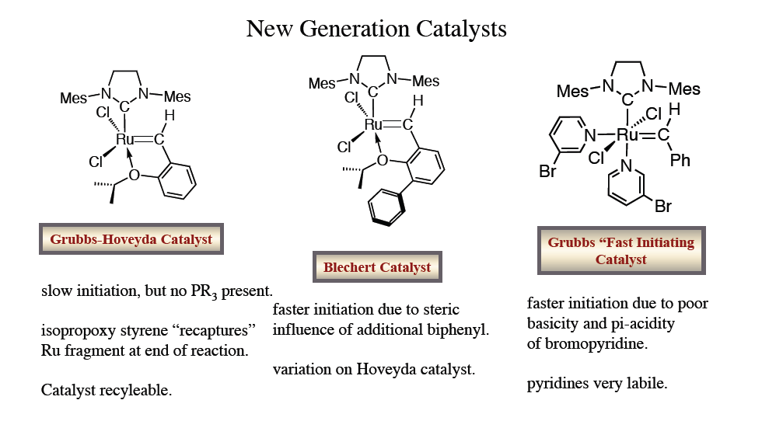
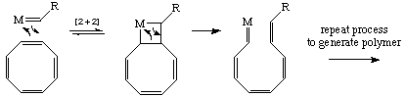
Types of Catalysts – Organometallics
Perhaps closest man has come to mimicking nature’s success
2005 Noble Prize in Chemistry
Well-defined, metal-based active sites
Selective, efficient manipulation of organic functional groups
Various forms, especially for polymerization catalysis
Difficult to generalize beyond organic transformations
ROMP:

Slide 8
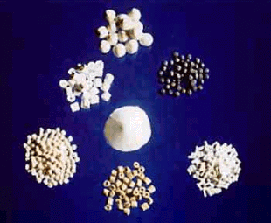
Homogeneous vs. Heterogeneous Catalysts
Zeolite catalyst
Catalyst powders
Homogeneous catalysis
Single phase
(Typically liquid)
Low temperature
Separations are tricky
Heterogeneous catalysis
Multiphase
(Mostly solid-liquid and solid-gas)
High temperature
Design and optimization tricky

Slide 9
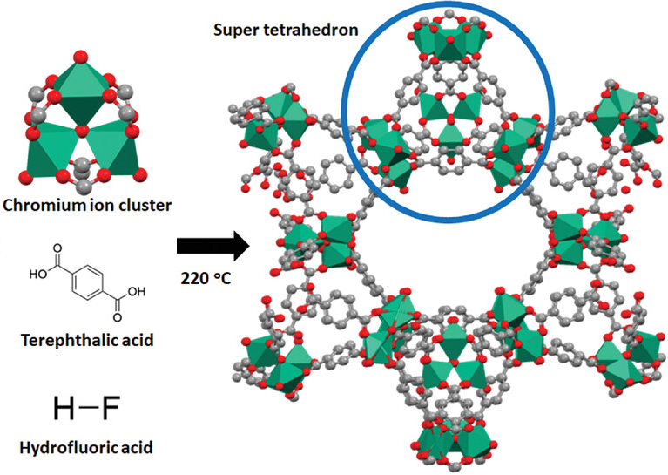
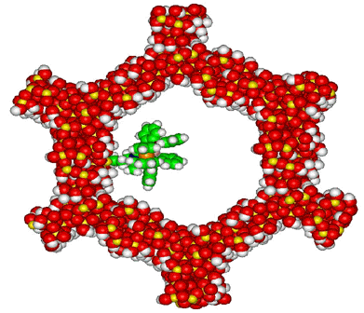
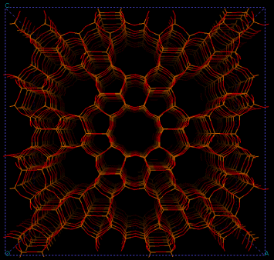
Microporous Catalysts
Porous on the scale of molecular dimensions
10 – 100 Å
Up to 1000’s m²/g surface area
Catalysis through
shape selection
acidity/basicity
incorporation of metal particles
Metal-organic framework
(2025 Nobel Prize)
10 Å
100 Å
Zeolite (silica-aluminate)
MCM-41 (mesoporous silica)

Slide 10

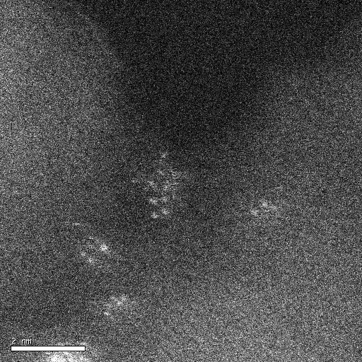
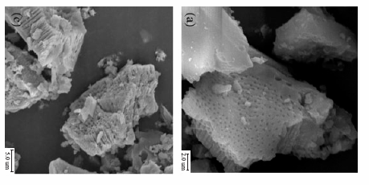
Amorphous Heterogeneous Catalysts
Amorphous, high surface area supports
Alumina, silica, activated carbon, …
Up to 100’s of m²/g of surface area
Impregnated with catalytic transition metals
Pt, Pd, Ni, Fe, Ru, Cu, Ru, …
Typically pelletized or on monoliths
Cheap, high stability, catalyze many types of reactions
Most used, least well understood of all classes
SEM micrographs of alumina and Pt/alumina

Slide 11
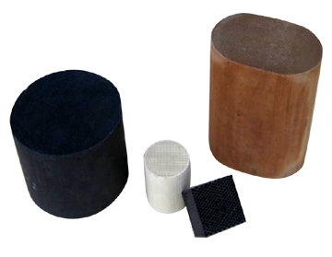
Sample Heterogeneous Catalytic Processes
Haber-Bosch process
N₂ + 3 H₂ → 2 NH₃
Fe/Ru catalysts, high pressure and temperature
Critical for fertilizer and nitric acid production
Fischer-Tropsch chemistry
n CO + 2n H₂ → (CH₂)_{n} + n H₂O , syn gas to liquid fuels
Fe/Co catalysts
Source of fuel for Axis in WWII
Water-gas shift
CO + H2O → CO2 + H2
Pd catalysts
Important in H2 production
Fluidized catalytic cracking
High MW petroleum → low MW fuels, like gasoline
Zeolite catalysts, high temperature combustor
In your fuel tank!
Automotive three-way catalysis
NO_{x}/CO/HC → H₂O/CO₂/H₂O
Pt/Rh/Pd supported on ceria/alumina
Makes exhaust 99% cleaner

Slide 12

Heterogeneous Catalytic Reactors
Design goals
rapid and intimate contact between catalyst and reactants
ease of separation of products from catalyst
Packed
Bed
Fluidized
Bed
Slurry
Reactor
Catalyst
Recycle
Reactor

Slide 13
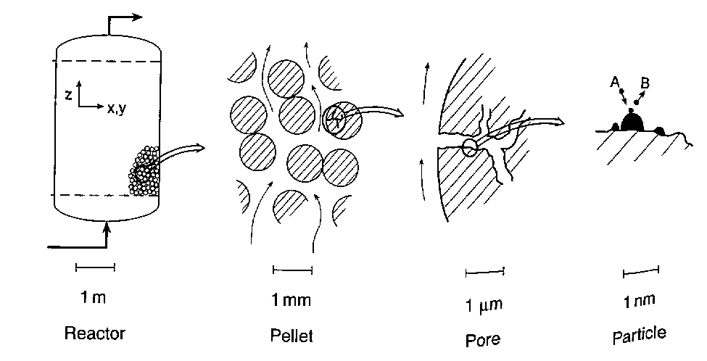
Length Scales in Heterogeneous Catalysis
Mass transport/diffusion
Chemical adsorption and reaction

Slide 14
Characteristics of Supported Catalysts
Surface area:
Amount of internal support surface accessible to a fluid
Measured by gas adsorption isotherms
Loading:
Mass of transition metal per mass of support
Dispersion:
Percent of metal atoms accessible to a fluid
M
M
M
support

Slide 15
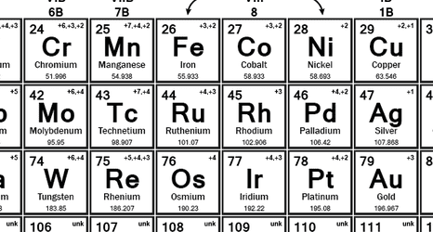
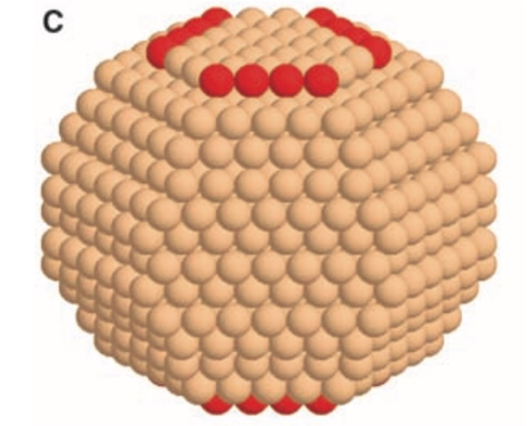
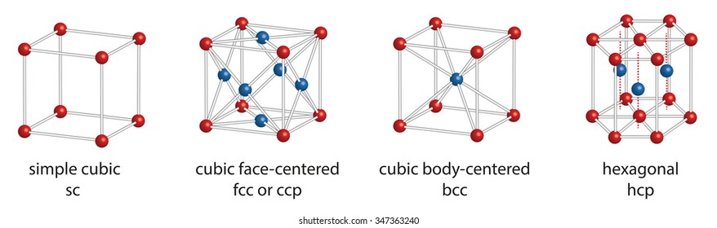
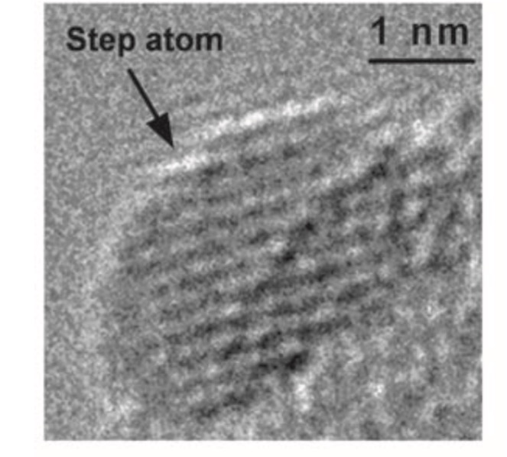
Transition Metal Catalysts
Filling d shell
Easier to reduce
More inert
More active
Harder to reduce
Metal particle exposing facets

Slide 16
Adsorption and Reaction at Solid Surfaces
Physisorption: weak van der Waals attraction of a fluid (like N₂ gas) for any surface
E_{ads} ~10 – 40 kJ/mol
Low temperature phenomenon
Exploited in measuring gross surface area
Chemisorption: chemical bond formation between a fluid molecule (like CO or ethylene) and a surface site
E_{ads} ~ 100 – 500 kJ/mol
Essential element of catalytic activity
Exploited in measuring catalytically active sites

Slide 17
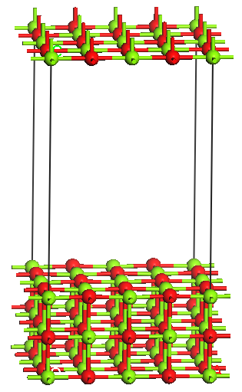
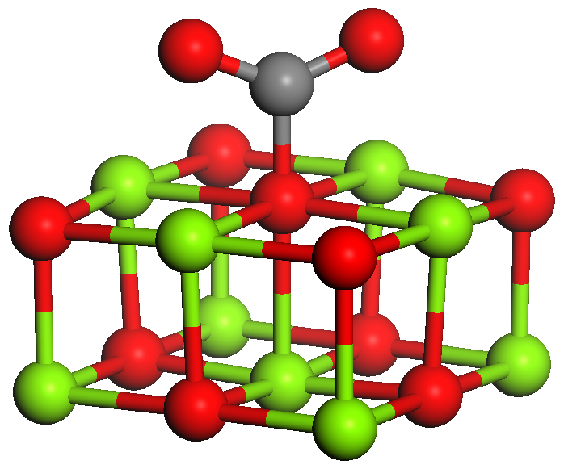
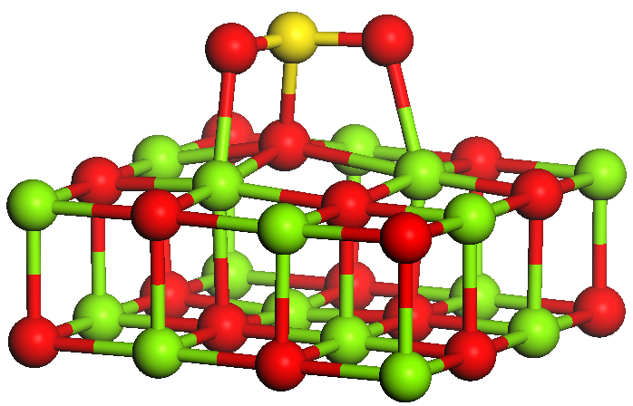
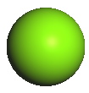
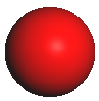
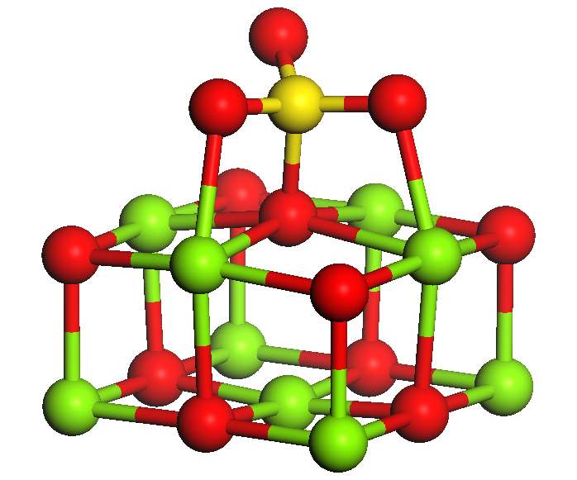
Physi- and Chemisorption on MgO(001)
CO₂
Physisorbed CO₂
-10 kJ mol⁻¹ GGA
Mg
SO₂
Chemisorbed SO₂
(“sulfite”)
-100 kJ mol⁻¹ GGA
O
SO₃
Chemisorbed SO₃
(“sulfate”)
-200 kJ mol⁻¹ GGA
MgO(001) supercell
Schneider, Li, and Hass, J. Phys. Chem. B 2001, 105, 6972
:

Slide 18
Concentrations in Heterogeneous Catalysis
Fluid concentrations
Traditionally reported as pressures (torr, atm, bar)
Ideal gas assumption: P_{j} = C_{j} RT
Surface concentrations
“Coverage” per unit area
n_{j} = moles_{j} / area
Maximum coverage called monolayer
1 ML: n_{j,max} = ~ 10¹⁵ molecules / cm²
Fractional coverage
θ_{j} = n_{j} / n_{j,max}
0 ≤ θ_{j} ≤ 1
Rate = f(P_{j},θ_{j})
Metal particle surface
θ_{j} = 1/6

Slide 19
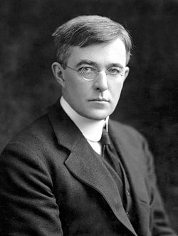
Adsorption Isotherms
Molecules in gas and surface are in dynamic equilibrium
A (g) + M (surface) ⇌ M-A
Isotherm describes pressure dependence of equilibrium
Langmuir isotherm proposed by Irving Langmuir, GE, 1915
Adsorption saturates at 1 monolayer
All sites are equivalent
Adsorption is independent of coverage
Irving Langmuir
1932 Nobel Prize
Equilibrium
rate_{ads} = rate_{des}
Site conservation
θ_{A} + θ* = 1
+

Slide 20
Using the Langmuir Isotherm
Example: CO adsorption on 10% Ru/Al2O3 @ 100°C
P_{CO} (torr) | 100 | 150 | 200 | 250 | 300 | 400
CO_{ads} (μmol/g_{cat}) | 1.28 | 1.63 | 1.77 | 1.94 | 2.06 | 2.21
n_{CO,∞} = 2.89 μmol/g_{cat}
K = 0.0082
10⁻³ mol Ru
Dispersion
(mol_{CO}/mol_{Ru}) = 0.29%
~1000 atoms

Slide 21
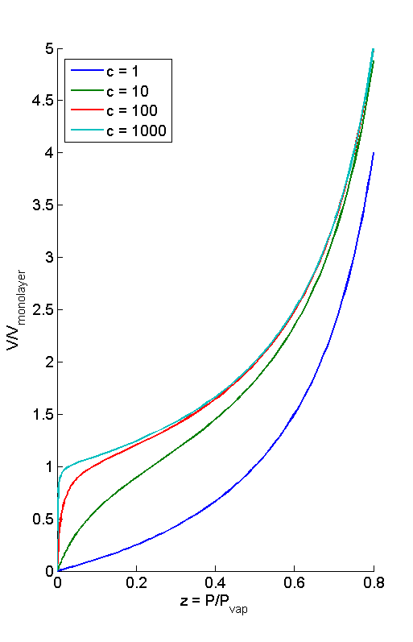
Brunauer-Emmett-Teller Isotherm (BET)
Relaxes Langmuir restriction to single layer adsorption
Monolayer adsorption; multilayer condensation
Useful for total surface area measurement
Adsorption of boiling N₂ (78 K)
ΔH_{ads}/ΔH_{cond}
ΔH_{cond}
ΔH_{ads}
Solid Surface

Slide 22
Temperature-Programmed Desorption

Slide 23
Competitive Adsorption

Slide 24
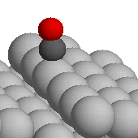
Rates of Catalytic Reactions
Pseudo-homogeneous reaction rate
r = moles / volume · time
Mass-based rate
r′ = moles / mass_{cat} · time
r′ = r / ρ_{cat}
Heterogeneous reactions happen at surfaces
Area-based rate
r′′ = moles / area_{cat} · time
r′′ = r′ / SA, SA = area / mass
Heterogeneous reactions happen at active sites
Active site-based rate
Turn-over frequency TOF = moles / site · time
TOF = r′′ / ρ_{site}
TOF (s⁻¹)
Hetero. cats. ~10¹
Enzymes ~10⁶

Slide 25
Surface Reaction Kinetics
Full kinetics
Site conservation
Langmuir-Hinshelwood kinetics
Steady-state approximation
Rate-limiting step approximation
Pre-equilibrium approximation

Slide 26
NH3 Oxidation
Friedrich Wilhelm Ostwald
1908 Nobel Prize
Ammonia slip catalyst

Slide 27
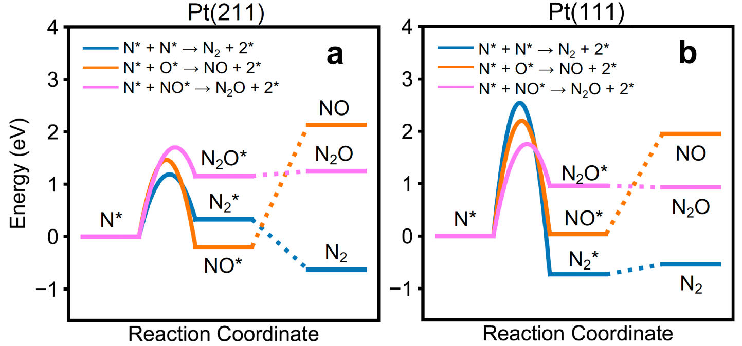
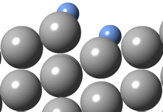
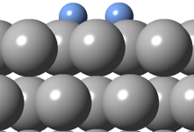
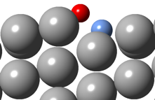
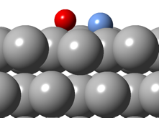
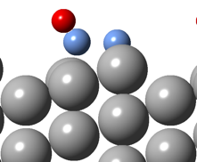
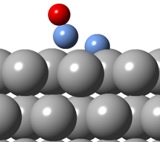
Comparative Bond Forming Pathways
E_{a,(211)}
E_{a,(111)}
N-N*
N-N*
<<
N-O*
N-O*
<<
N-NO*
N-NO*
≈
Non-BEP behavior, structure sensitive
Notes:
1. why are NO and N2 barrier heights reversed from product energies on given facet? Agrees with literature?
1. Formation of N2 and NO have much lower barriers. The formation barrier for N2O is similar on both surfaces
2. Right figures are the TS of products formation. The lower barriers of N2 and NO originate from the stabilized transition states on step sites of (211). N2O forms on terrace sites of both surfaces and the reaction barriers are comparable.

Slide 28
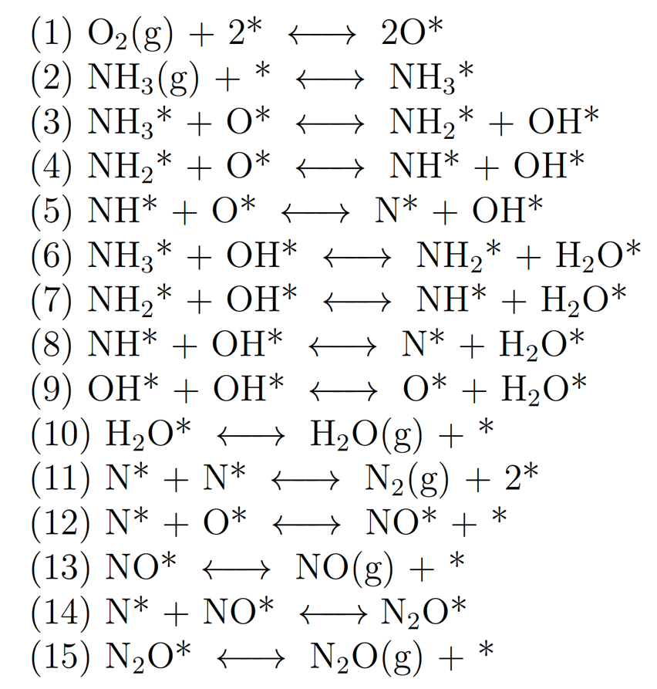
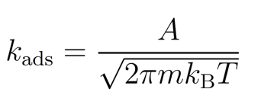
DFT to Reaction Rates and Selectivities
Reaction Mechanism
Transition State Theory
µkinetic model
Surface reactions
Non-activated adsorption
Mass + site balances
Thermodynamic Consistency
Coverages
Rates

Slide 29
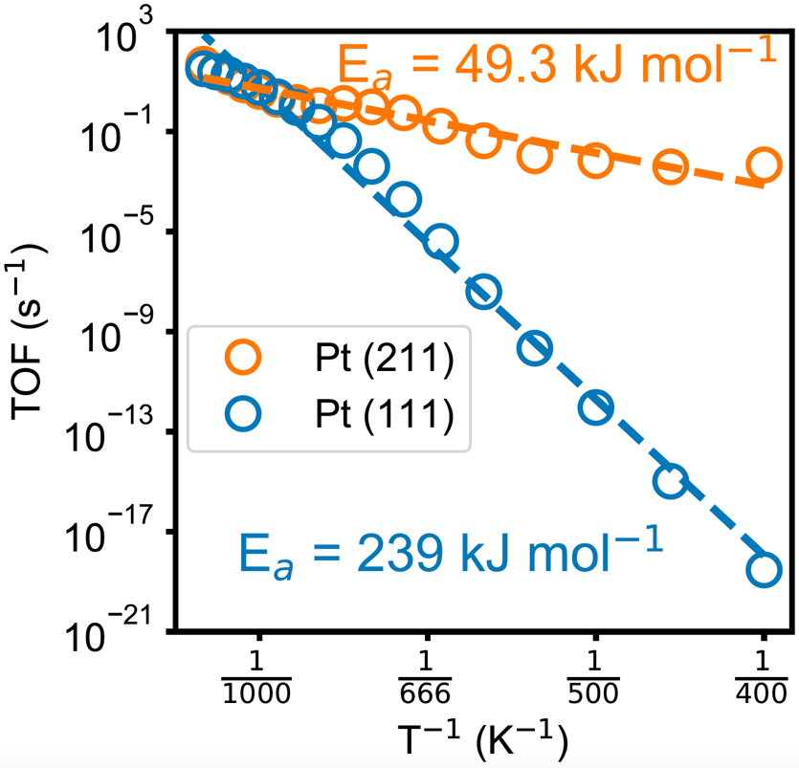
NH3 Oxidation Analysis
Ma and Schneider, ACS Catal. 2019, 9, 2407
Notes:
Pt(211) shows much higher rate on Pt(111) at low and intermediate T. The TOF converges at high T.
At low T, multiple reactions control the rate on Pt(211), with barriers lower than 1.6 eV. N2 formation controls the rate on Pt(111), with a much higher barrier, 2.5 eV.
Similarly, between 600~1000K, multiple reactions with low barriers control the rate on Pt(211). NO formation, with a high barrier, controls the rate on Pt(111).
At high T, ammonia activation controls the rates on both surfaces. The reaction has similar barriers and therefore rates on two surfaces.

Slide 30
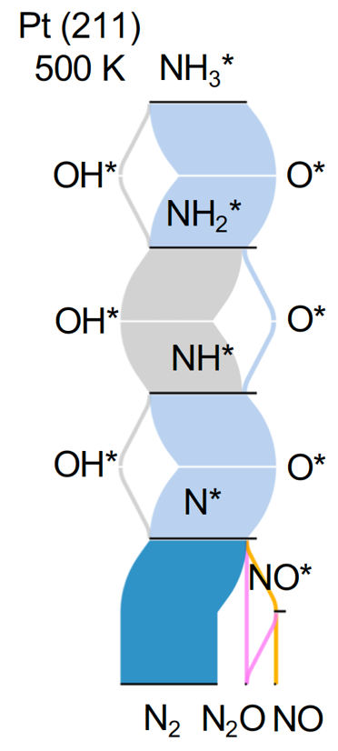
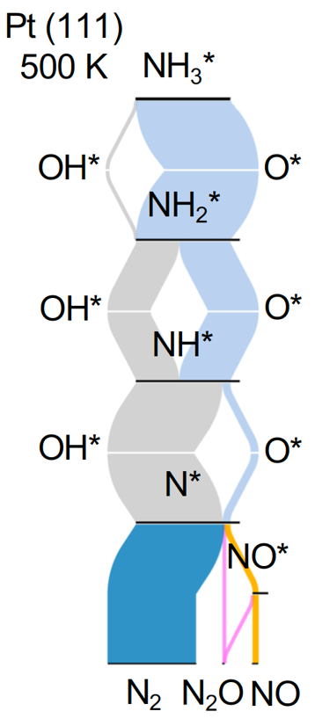
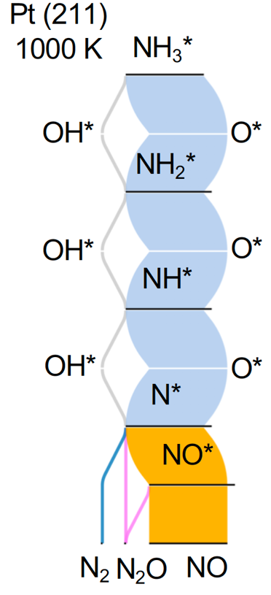
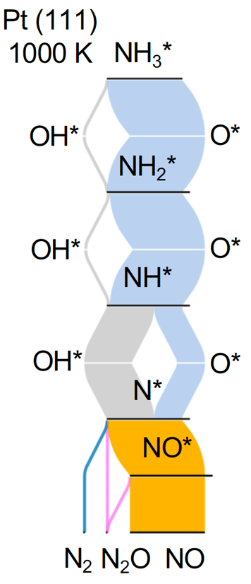
Reaction Fluxes and Rate Selectivity
NH3 slip regime
Ostwald regime
Preferred pathways sensitive to facet…
…and to temperature
But products are not!
Notes:
At low T, ammonia oxidation is selective to N2. At high T, ammonia oxidation is selective to NO, regardless of the Pt surface and reaction flow pathways.
OH pathway shows more contributions at low T.

Slide 31
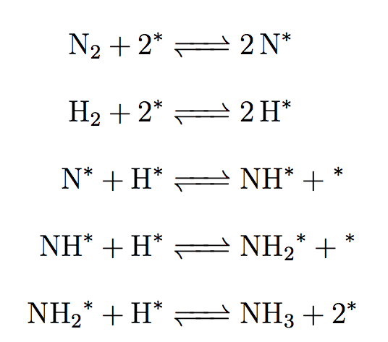
Sabatier Principle
Vojvodic et al. Chem. Phys. Lett. 2014, 598, 108

